Slide 1
Quick Sort
Divide and Conquer

Slide 2
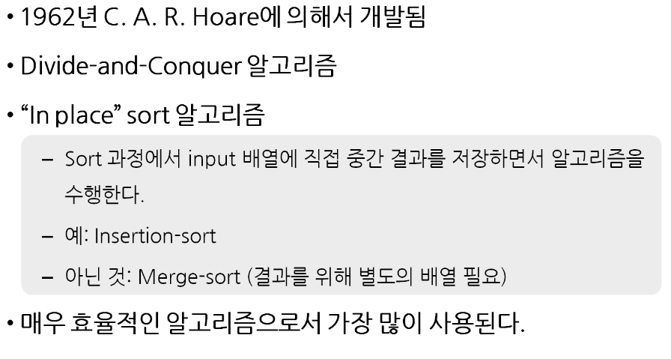
Quick Sort

Slide 3
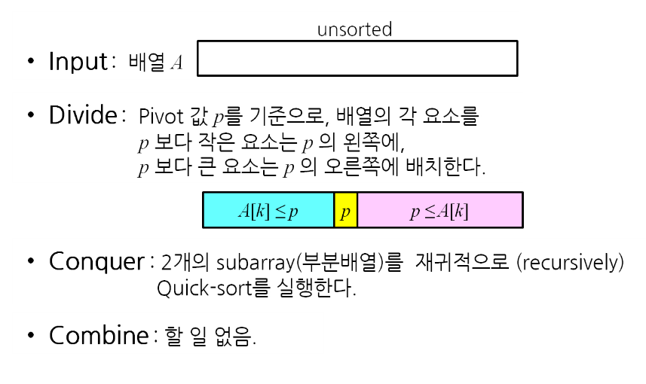
Quick Sort : Divide and Conquer

Slide 4
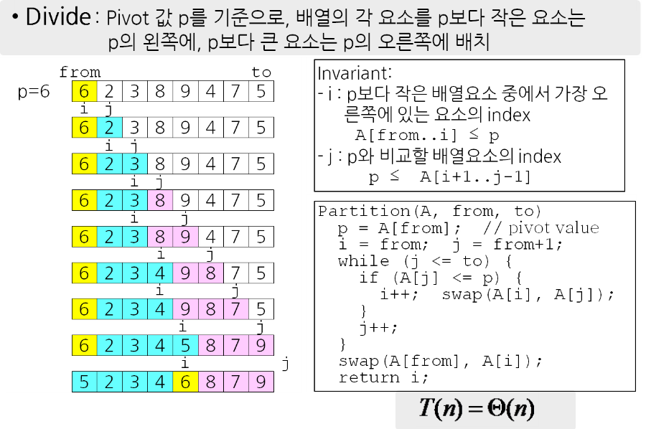
Array Partitioning

Slide 5
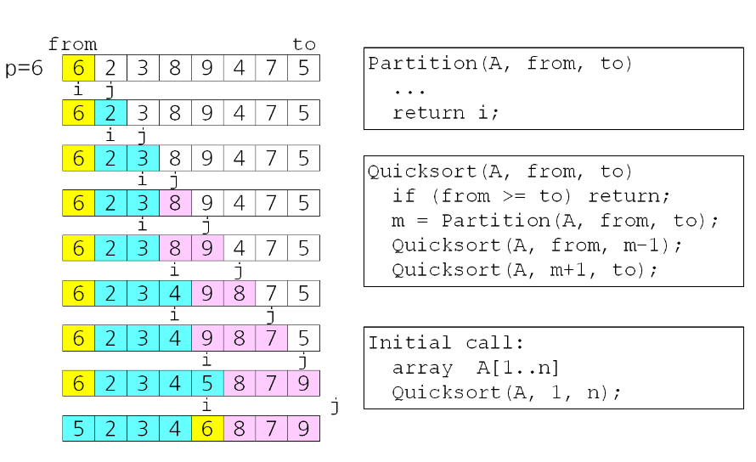
Quick Sort 알고리즘

Slide 6
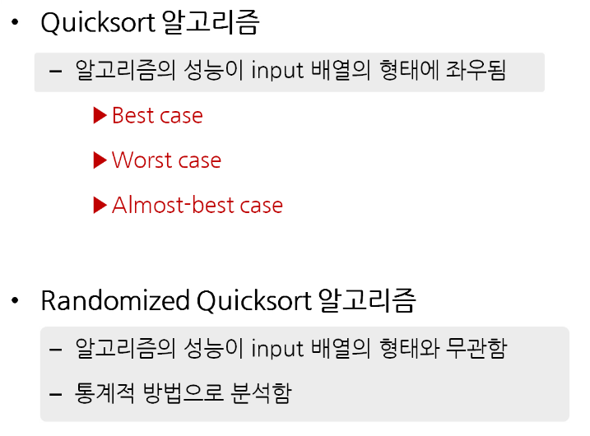
Quick Sort 알고리즘의 분석

Slide 7
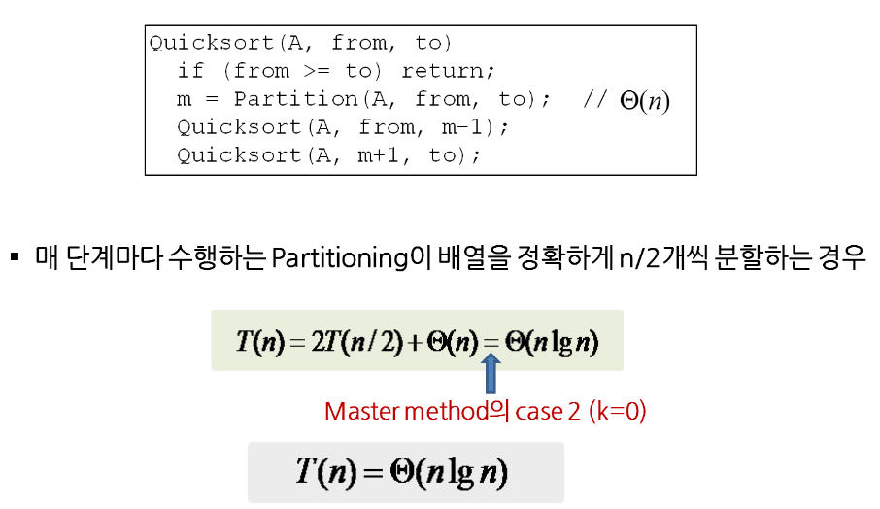
Quick Sort – Best Case

Slide 8
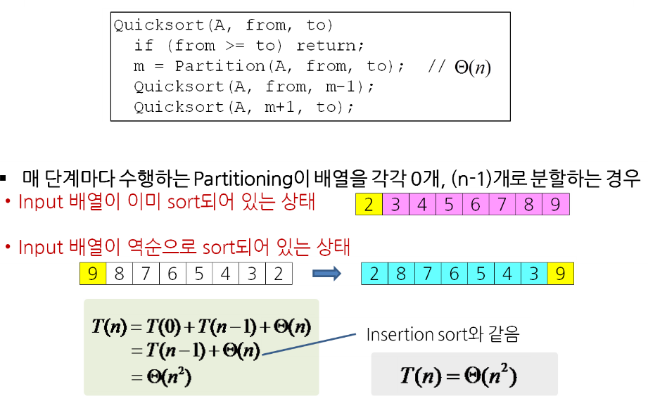
Quick Sort – Worst Case

Slide 9
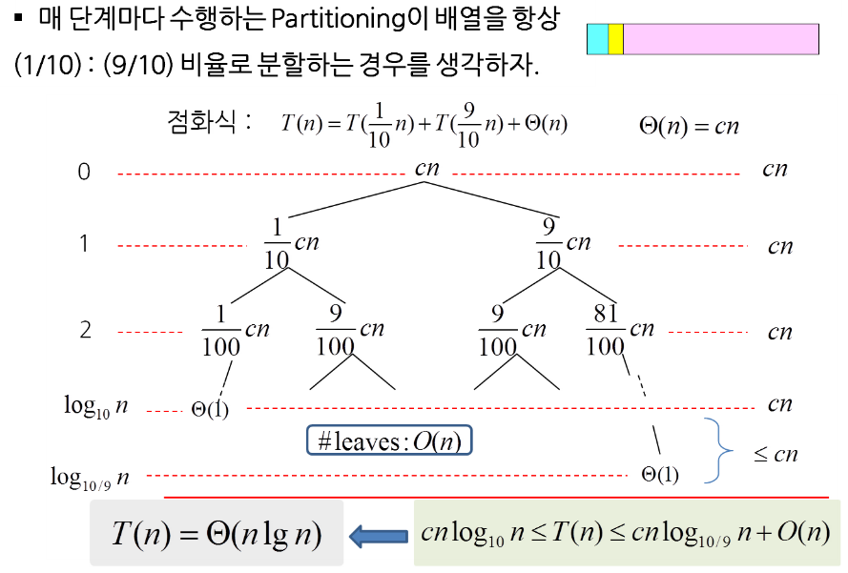
Quick Sort – Almost best Case
- 참고자료

Slide 10
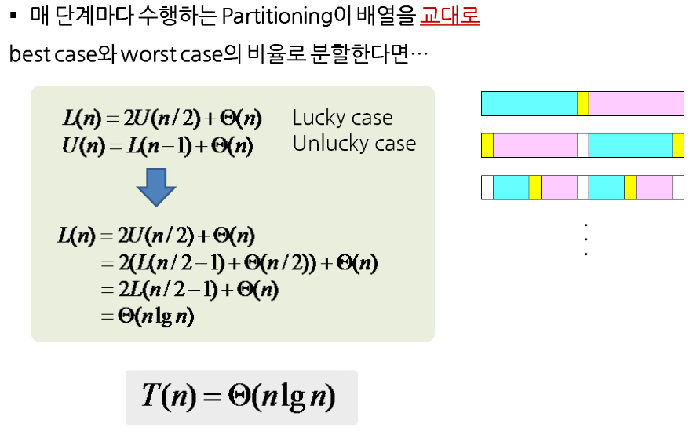
Quick Sort –Best & Worst Case
- 참고자료

Slide 11
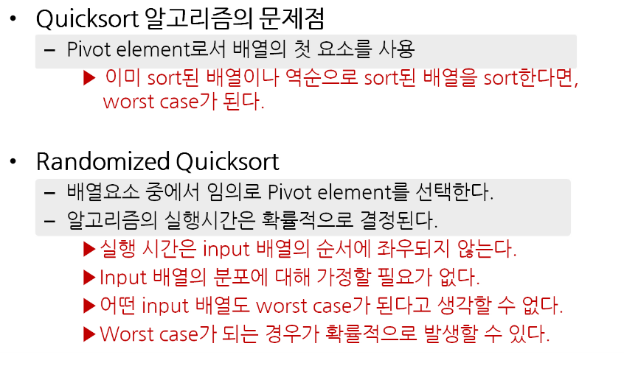
Randomized Quicksort

Slide 12
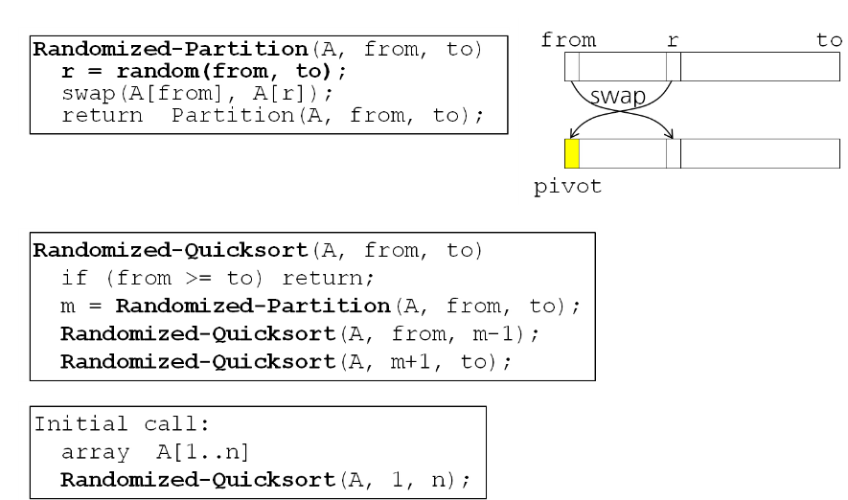
Randomized Quicksort 알고리즘

